Slide 1
Accelerator Architecture

Slide 2
Rationale for Accelerator Devices
CPUs are not optimized for specific applications
Generic instruction sets
Support diverse workload types
Implementation a compromise between supported features, physical constraints, and final product price
Limited transistor budget per chip
Power constraints
Custom architectures potentially provide multiple benefits
Designed and optimized for specific function or task
Drastically improved performance for “native” applications
Better power characteristics
Improved performance per Watt
Better I/O integration (pin counts, connector types, protocol support, bandwidth matching of attached peripherals, etc.)
May be manufactured relatively cheaply if deployed in volume
Easy integration when leveraging industry standard interfaces

Slide 3
Accelerator Drawbacks
Not generic purpose
Poor performance for workload classes inconsistent with device’s purpose
Heterogeneous
Different architecture and execution model to that of host processor
Impose refactoring of application code into accelerated and non-accelerated (i.e., executed on conventional CPU) segments
Require specialized kernel drivers
May be more difficult to program and optimize
May require custom language extensions and libraries
Knowledge of underlying architecture details is usually necessary to write a good code
Imposes explicit management of computations on the programmer (data and work offload, device identification and setup)
Limited portability to other device classes or even between accelerators of the same type but from different vendors
Potentially steep learning curve for the uninitiated
Additional system component
Hardware cost
Another energy sink (make sure your power supply is sufficient)
Integration issues (space, cooling, interface availability)

Slide 4
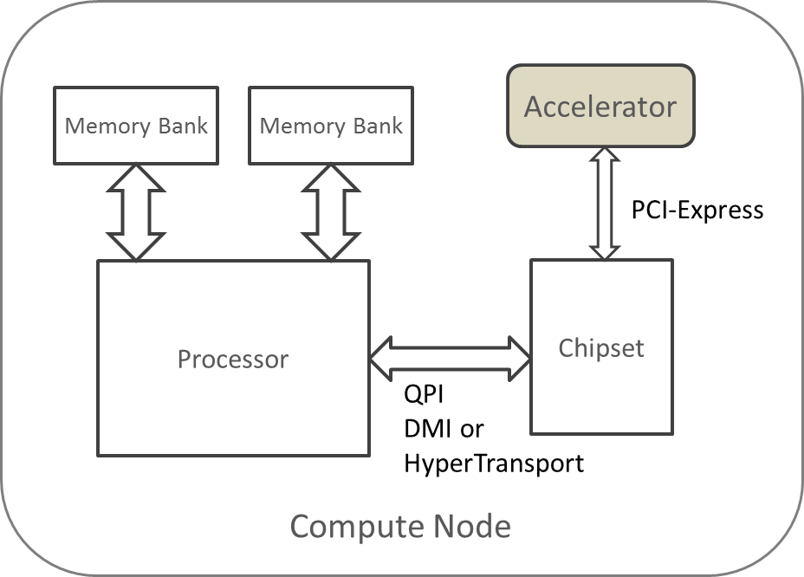
Placement in a Conventional System
Use industry-standard interfaces (typically PCIe)
Modern CPUs provide PCIe endpoints directly on die

Slide 5
Common Accelerator Types
Graphics and video processing
Arithmetic
Double-precision floating-point
Multimedia processing
Encoding
Decoding
Multiplexing
Digital Signal Processing (DSP)
Cryptography
I/O, smart DMA
Artificial Intelligence

Slide 6
Early Accelerators: Coprocessors
Date back to 1970s
Initially a separate device
Required a dedicated socket or pad pattern to solder a chip
Specialized connecting interface (data and control)
Custom access sequence
Later, included on the same die as the main processor (e.g., System on Chip) when logic density sufficiently increased
Tightly integrated and cooperating with the host processor
Hardware controlled offload by
Special instruction format and arrangement of control signals or
Memory mapped access to control and data registers
Custom synchronization mechanism
Very limited portability between processor families

Slide 7
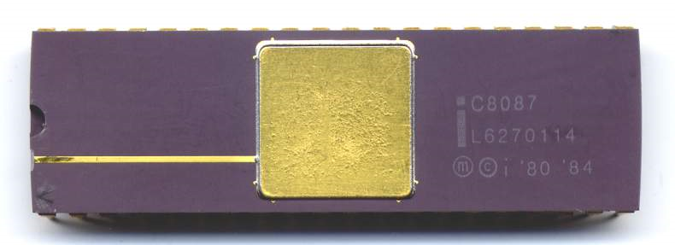
Example: Intel 8087
Released by Intel in 1980
Numerical floating-point coprocessor for the i8086 family
Single- (32-bit), double- (64-bit), and extended-precision (80-bit) floats
16, 32, and 64-bit signed binary integers, and 80-bit BCD integers
About 60 instructions (add/subtract, multiply/divide, sq. root, trigonometric functions, base 2 logarithm, conversions)
Influenced by the upcoming IEEE754 standard, but not compliant
Implemented in 3µm HMOS process, 45,000 transistors
Achieved 50kflops using 2.4 Watts (speed variants from 4 to 10MHz)
Cloned by AMD and Cyrix

Slide 8
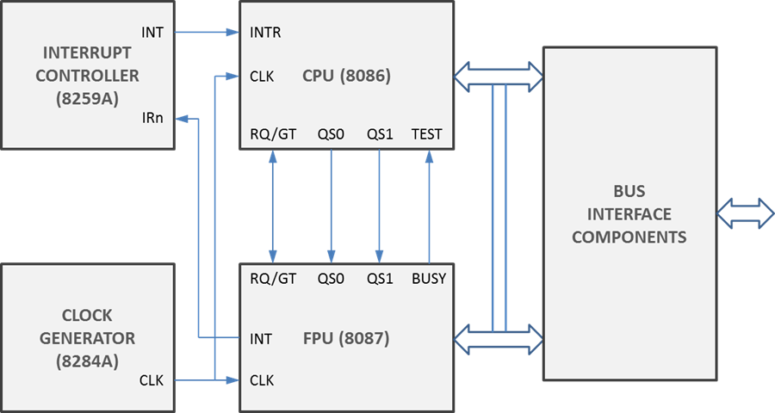
Intel 8087 System Interface
Shares address and data buses with the main CPU
“Escape” instructions redirects work to coprocessor
Memory operands required the main CPU to perform a dummy memory access
Concurrent operation with CPU crash prone due to potential bus conflicts
In practice, the CPU has to wait for the coprocessor to finish the computation (FWAIT instruction)

Slide 9
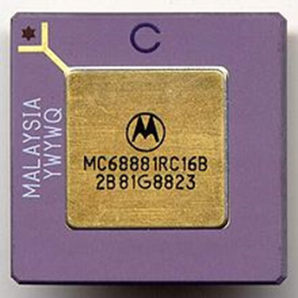
Example: Motorola MC68881
Introduced by Motorola in 1984
Companion to MC68000 family with 32-bit data buses
Implemented in an HCMOS process using 155,000 transistors
Floating-point coprocessor
Single, double, and extended precision floats
96-bit packed BCD floats
8, 16, 32-bit integers
IEEE754 compliant
Add/subtract, multiply/divide, sq. root, trigonometric and inverse functions, hyperbolic functions, exponentiation, logarithms
Achieved 240kflops at 25MHz consuming 0.75 Watts

Slide 10
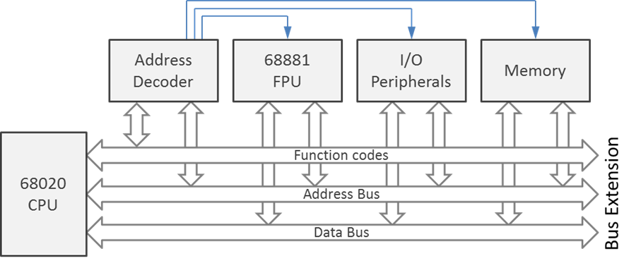
MC68881 System Interface
Memory-mapped control registers
Uses standard system bus
Coprocessor may use all addressing modes supported by the main CPU
Coprocessor may run at a different clock speed than CPU
Single CPU may control up to eight coprocessors

Slide 11
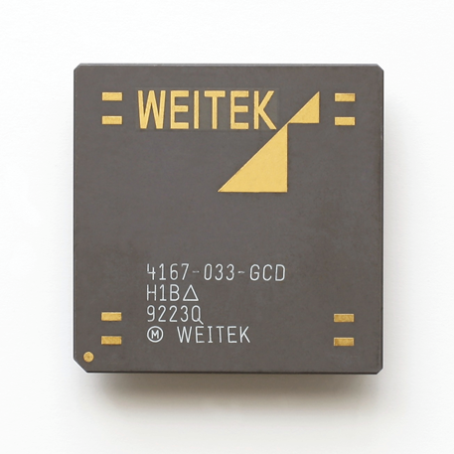
Example: Weitek 3167
Memory-mapped interface
Communication via memory move instructions
Often used interposition socket due to incompatible pin arrangement with existing coprocessors
The fastest FPU on the marked at release time
Linpack: 1.36 (SP) and 0.6 (DP) Mflops
Whetstone: 5.6 (SP) and 3.7 (DP) Mflops
Dissipated 1.84W at 25MHz
Replaced by W4167 with approximately 3× better performance (shown)

Slide 12
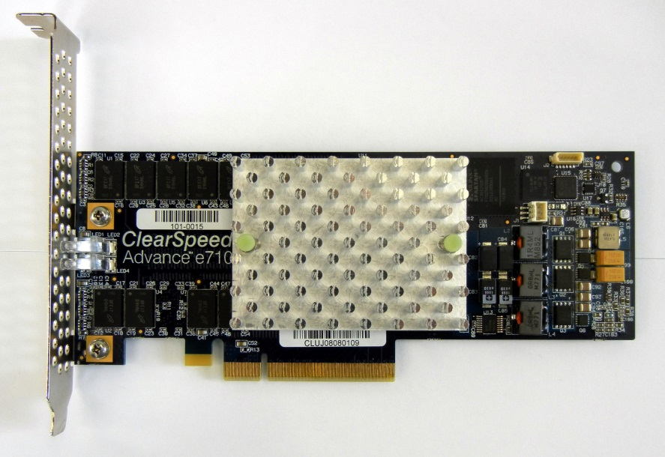
Example: Clearspeed Advance
Use industry-standard interfaces
Version X620 equipped with PCI-X interface (2005)
Dual CSX600 SIMD processors, each comprising 96 double-precision processing elements
128 million transistors in 130nm process
Sustained 33Gflops at 250MHz while dissipating 10W
1GB ECC on-board memory
Employed in Tsubame cluster (7th place on Top500 in 2006)
PCIe connectivity used in version e710 (2008 – shown)
Dual CSX700 processors
96Gflops at 12W
2GB memory

Slide 13
Introduction to Graphics Processing Units
Optimized for generation of 2D perspective projections of 3D objects
Need to correctly orient and scale objects, figure out occlusion by other objects, and compute object color attenuation due to shading, incident light color and intensity, and object surface properties (reflectivity, etc.)
Types of computation include floating-point matrix-vector multiplication, dot products, weighted vector sum
Multiple computations may be required for each pixel in the frame due to antialiasing
Additional support is needed for textures, environment-enhanced mapping, fog, and other effects
Smooth video rendering therefore requires a large number of floating-point operations per second
Some of the realism may be sacrificed to obtain the desired rendering speed

Slide 14
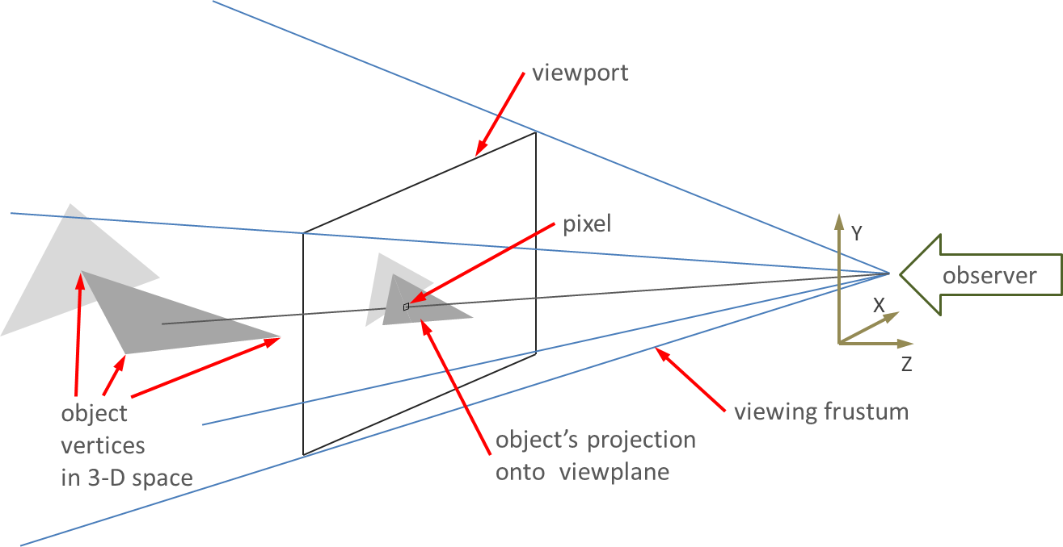
Elements of a 3D Scene

Slide 15
GPU Protoplasts
Player-missile or sprite graphics in 8-bit computers
2D graphics adapters popularized by IBM PC
Color Graphics Adapter popularized by IBM PC (two colors at 640x200 pixels or 80x25 text mode)
Enhanced Graphics Adapter (16 simultaneous colors, 640x350 pixels)
Video Graphics Array (640x400/16 colors or 320x200/256 colors, 18-bit RGB values)
Self-contained solutions:
TMS34010 by Texas Instruments (fixed-function 2D accelerator, drawing primitives in software)
IBM 8514 (hardware line drawing, area fills, block transfers, raster operations)

Slide 16
Early GPUs
Silicon Graphics Inc. workstations
3D rendering inspired by Stanford Geometry Engine
100s of thousands (1991) to >10 million polygons per second
Add-on 3D rendering cards
Voodoo line from 3dfx Interactive
Combined 2D and 3D acceleration
ViRGE by S3, Rage from ATI, etc.

Slide 17
Growth of GPU Capabilities
Standard 2D hardware acceleration
Line drawing, polygon fills, BitBLTs
3D rendering features
Perspective transformation
Shading: flat and Gouraud
Texture mapping and filtering
MIP-mapping
Alpha-blending (translucency)
Depth queuing
Fogging
Z-buffering
Simple video decoding support (e.g., MPEG-1)
T&L: transform, clipping, and lighting support in hardware
Stencil buffers (shadow and reflection rendering)
Anti-aliasing
High dynamic range (HDR)
Advanced video codecs

Slide 18
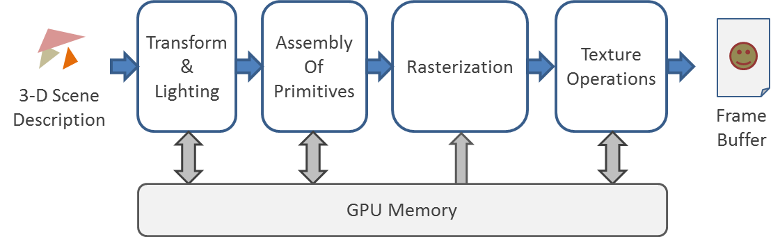
Fixed-Function Graphics Pipeline

Slide 19
Modern GPU Attributes
Unified shaders
Introduced by Nvidia’s GeForce 8 and AMD’s Radeon HD2000 series
Fully programmable by user/video driver developer
No longer assigned to perform a predefined function at a specific pipeline stage
Shared internal storage accessible to shader code further improves processing efficiency (scratchpads, caches)
Double-precision arithmetic added in 2007 enables broad class of scientific computations (but not always in strict compliance with IEEE754)
Microarchitecure optimizations for
Tessellation, primitive discard acceleration
Asynchronous processing
Independent scheduling and work dispatch
Offload management
Fine-granularity preemption
2D operations now emulated by 3D processing hardware
Availability of higher-priced and more stable GPGPUs targeting computational workloads in addition to consumer line of products

Slide 20
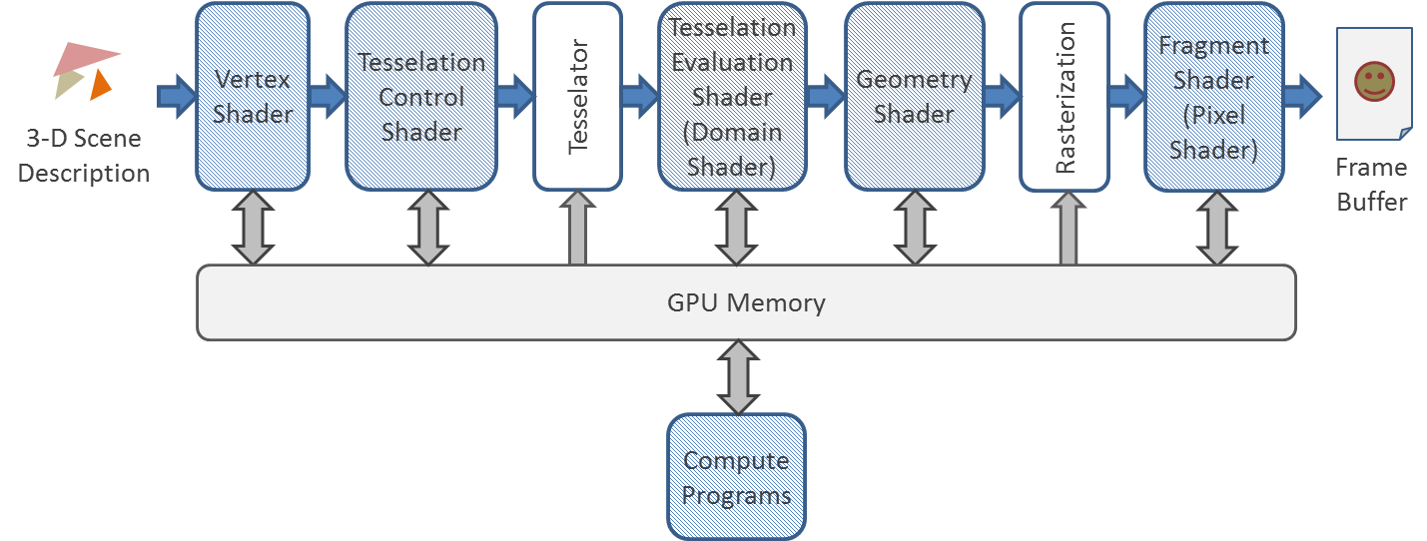
Modern Rendering Pipeline

Slide 21
Comparison of Recent GPUs
Company | Product Name | Product Type | Transistor Count [billion] | Base Clock [MHz] | Peak FP GFlops |  | Memory Bandwidth [GB/s] | Memory Bus Width | Max. Power [W]
 |  |  |  |  | SP | DP
AMD | Radeon R9 Fury X | GPU | 8.9 | 1050 | 8601.6 | 537.6 | 512 | 4096 | 275
AMD | FirePro W9100 | Accel. | 6.2 | 930 | 5240 | 2620 | 320 | 512 | 275
Nvidia | GeForce GTX Titan X | GPU | 8 | 1000 | 6144 | 192 | 336 | 384 | 250
Nvidia | K40 | Accel. | 7.1 | 745 | 5040 | 1680 | 288 | 384 | 235

Slide 22
Modern GPU Example: Nvidia Pascal
Released in 2016
Increased number of double-precision FPUs
Addition of “half-precision” floating-point mode for deep learning, sensor processing, and radio astronomy applications
Second generation, stacked high-bandwidth memory (HBM2) for increased capacity and bandwidth
Simplified (to the user) offload mechanism through unified access to system memory and demand paging
High-speed NVlink bus
Improved performance of atomic operations targeting data in on-chip memories and external DRAM

Slide 23
Pascal GPU Parameters
Parameter | Value
Technology node | TSMC 16 nm Fin-FET
Transistor count | 15.3 billion
Die size | 610 mm²
Clock frequency | 1328 MHz (1480 MHz boost)
Memory type | HBM2
Memory size | 16 GB
Memory bus width | 8x512 bits
Memory bandwidth | 720 GB/s
Thermal design power | 300 W
Resource counts (per GPU)
Streaming multiprocessors (SMs) | 56 (max. 60)
CUDA cores | 3584
Texture Processing Clusters (TPCs) | 28
Texture units | 224
Register file size | 14336 KB
L2 cache size | 4096 KB
FP32 CUDA cores | 2584
FP64 CUDA cores | 1792
Aggregate performance
Peak double-precision | 5.3 TFlops
Peak single-precision | 10.6 TFlops
Peak half-precision | 21.2 TFlops

Slide 24
Got here WI 2023

Slide 25
Pascal Architecture (I)
Pascal chip comprises
Stream Multiprocessors (SMs) grouped in clusters (GPCs)
Eight 512-bit wide HBM2 interfaces associated with memory controllers
Global thread scheduling engine
L2 Caches
16-lane PCIe 3.0 host interface
4 NVlink interfaces
Each SM includes
64 single- and 32 double-precision CUDA cores
Instruction buffer
Thread scheduler
Two dispatch units
128KB register file
64KB L1 data cache

Slide 26
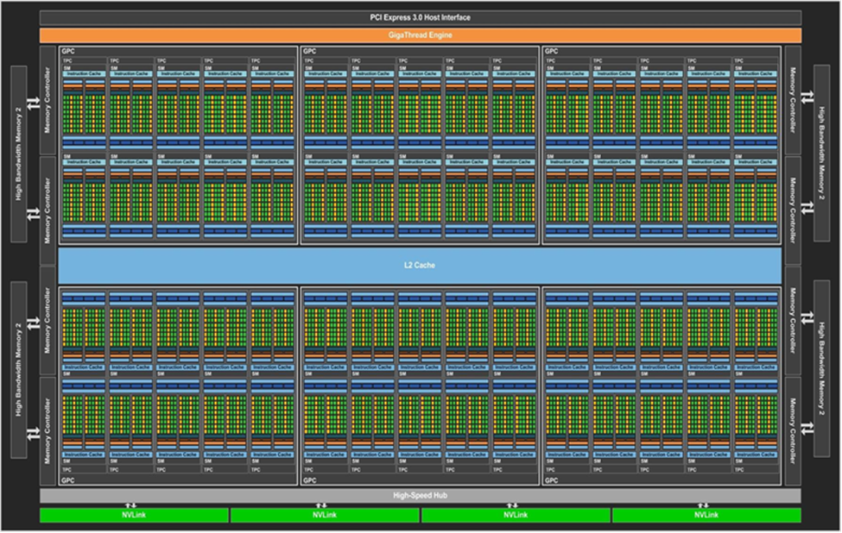
Pascal Architecture (II)

Slide 27
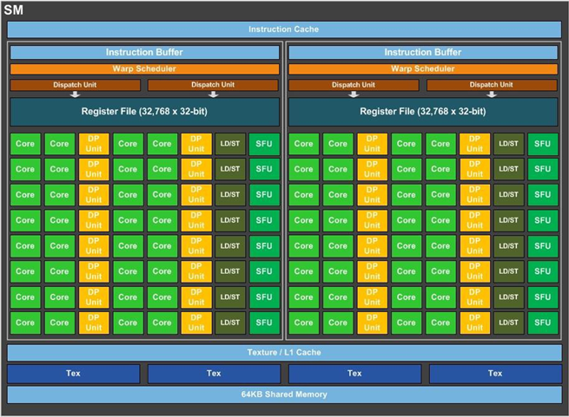
Details of Stream Multiprocessor

Slide 28
2021 Note
Since pascal Nvidia GPUs have gone -> Volta (/Turing) which was the addition of tensor cores and some ray-triangle and BVH traversal hardware -> Ampere
Ampere adds some better tensor cores (support for more data types), faster memory
That’s basically the same architecture as pascal otherwise.
The next generation (Lovelace and Hopper likely) we don’t really know what they’ll contain yet.

Slide 29
E.g. A100 (Ampere)
6912 cuda cores, 40 or 80 gigs of ram. 54 Billion transistors.
Graphics memory (GDDR) is better at certain types of memory operations than regular DDR (and the reverse).
Basically: Graphics memory is in order reads and writes, and writing large buffers
DDR (Regular RAM) is supposed to provide fast access to one cache line of memory (64 bytes currently in DDR5, 32 in DDR4). That means a cache miss in DDR4 is 2 memory accesses, in DDR5 it will be 1 (for now).

Slide 30
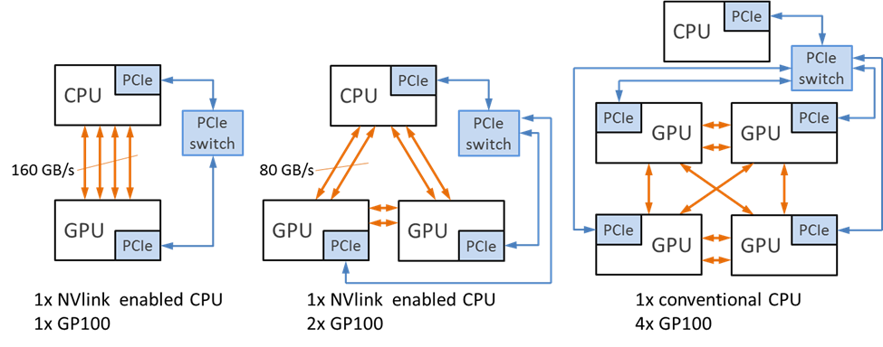
Sample NVlink Topologies

Slide 31
GPU Programming Environments
CUDA
Modified C++ compiler
API and library
GPU-specific data attributes and task syntax
Limited to Nvidia GPUs
OpenACC
Directive based (#pragma)
Custom compiler and API
Focus on simplicity and portability
OpenCL
C-like programming language and API
Supports program development on all elements of heterogeneous platform and defines interactions between them
Higher level data types and qualifiers for events, functions, address spaces, and access
Operator overloads for vector operations
Extensive library of mathematic, geometric, vector, image, memory, and synchronization functions

Slide 32
Heterogeneous System Architecture
Developed by non-profit HSA Foundation including industry and academic members
Provides ISA-independent runtime and system architecture APIs
Identifies two types of compute units
Latency Compute Unit (conventional CPU)
Throughput Compute Unit (accelerator)
Both unit types share cache-coherent physical memory implementing a unified virtual address space
Shared page tables
Data access accomplished through pointer passing (no data copies!)
Page fault support
Limited reliance on system calls
Improved task queueing at execution devices
Found in Systems on Chips (SoCs) and AMD Accelerated Processing Units (APUs)

Slide 33
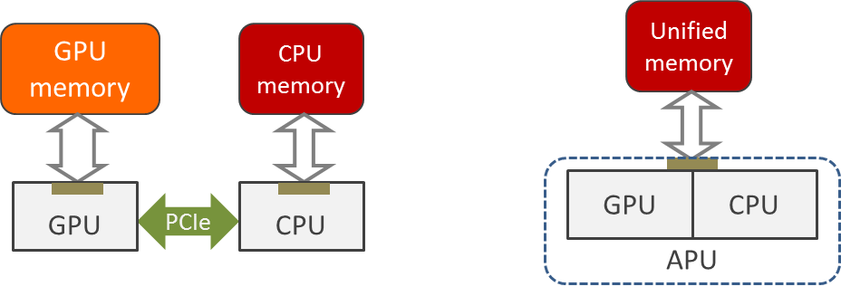
Comparison of System Topologies with Discrete and Unified Accelerators

Slide 34
AMD APU Parameters
Architecture Codename | Fabrication Process [nm] | Die Size [mm²] | CPU |  |  | GPU |  | Memory Support | Max. TDP [W]
 |  |  | Architecture | Clock [GHz] | Max. Cores | Clock [MHz] | Shaders
Kaveri | 28 nm | 245 | Steamroller | 4.1/4.3 | 4 | 866 | 512 | DDR3-2133 | 95
Carrizo | 28 nm | 245 | Excavator | 2.1/3.4 | 4 | 800 | 512 | DDR3-2133 | 35
Bristol Ridge | 28 nm | 250 | Excavator | 3.7/4.2 | 4 |  | 512 | DDR4-2400 | 65

Slide 35
Tensor Cores
Building on the idea of GPGPU
Analysing the types of calculations used, Nvidia realised matrix multiply-accumulate operations are central to lots of accelerated applications (Deep learning, signal processing etc.)

Slide 36
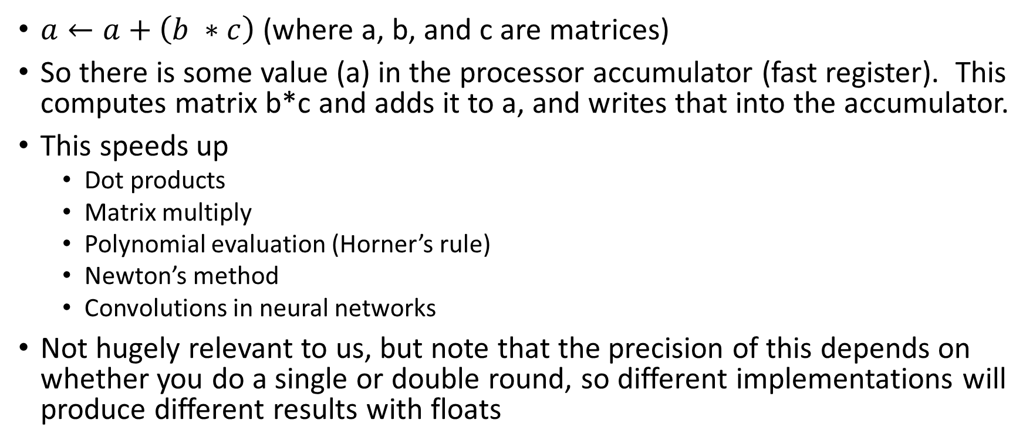
Multiply Accumulate
$a←a+\left(b ∗c\right)$ (where a, b, and c are matrices)
So there is some value (a) in the processor accumulator (fast register). This computes matrix b*c and adds it to a, and writes that into the accumulator.
This speeds up
Dot products
Matrix multiply
Polynomial evaluation (Horner’s rule)
Newton’s method
Convolutions in neural networks
Not hugely relevant to us, but note that the precision of this depends on whether you do a single or double round, so different implementations will produce different results with floats
Notes:
https://en.wikipedia.org/wiki/Multiply%E2%80%93accumulate_operation

Slide 37
Programming Platforms
So how do you program a tensor processor from Nvidia? CUDA
What is CUDA?

Slide 38

CUDA (compute unified device architecture) is a gpu computing language from Nvidia, it’s for C/C++/Fortran
It largely grew out of compute shaders, and exists to solve a different problem than Direct3D or OpenGL
It’s probably the dominant GPGPU compute language still
Though.. Problem: Windows and Linux only and it requires an Nvidia GPU.

Slide 39
AMD (ATI gpus from Markham)
AMD has stumbled around in this space for a while
They had a ‘close to metal’ initiative, that became the AMD stream API that became the AMD APP all 3 of which are dead initiatives
AMD makes GPU’s in this space (the Radeon Pro lineup)
But programming is done through (probably better) multiplatform APIs

Slide 40
Alternatives?
DirectCompute (The DirectX counterpart to CUDA)
DirectCompute works on AMD and Nvidia GPUs… which is good
But it’s really part of a game engine library, also, Windows/Xbox only for
(Don’t let Sri get sidetracked on this but DirectX is relatively narrowly focused on making game engine type things, whereas OpenGL is more ‘anything 3D’)

Slide 41
OpenCL
You’ll have heard of OpenGL as the cross platform graphics library that’s pretty good at everything.
OpenCL is basically the GPU accelerated compute language that spun off from that
OpenCL connects nicely with Vulkan (sort of a low level API from the OpenGL people)

Slide 42
Others?
There are other GPU libraries,
WebGPU
C++AMP (built on DirectX)
RenderScript (Replaced by Vulkan)
Some AI and Deep learning specific ones, some for Audio processing (which is a similar problem mathematically)
And Intel has something useless for Larabee (also useless) that still shambles along as a zombie (Larabee is completely different from Arc/Xe)

Slide 43
The Problem
That tech stack is really not aimed at HPC
What we really want is something that’s easy to accelerate code on
Cross hardware, Linux
What if we designed a GPU accelerated language in the style of OpenMP?

Slide 44
The Essential OpenACC

Slide 45


Slide 46
Common GPU Programming Environments
CUDA (Compute Unified Device Architecture)
C, C++, and Fortan language support (custom compilers)
Limited to Nvidia devices (GeForce, Quadro, Tesla)
Optimized libraries for FFT, BLAS, dense and sparse solvers, graph analytics, random number generation, and physics simulation
OpenCL
Heterogeneous environment support (including host and devices)
ISO C99 and C++14 programming API
Distinguishes four levels of memory hierarchy on accelerators
C++ AMP
Set of extensions and C++ compiler developed by Microsoft
Specifies two devices types for function execution, cpu and amp
N-dimensional array data and index objects with associated views
OpenACC
Directive based, discussed further here

Slide 47
Open Accelerators (OpenACC)
“Directives for accelerators” (pragmas)
Directives are ignored if compiler cannot support them
Initial specification created by PGI, CAPS entreprise, Cray, and Nvidia in 2011
C, C++, and Fortran languages
Focus on simplicity and portability
User explicitly identifies sections of code that may be offloaded to accelerator
Most recent API specification is v2.5 (Oct. 2015)
Available compilers include PGI, Pathscale, GCC 6, OpenUH, and OpenARC

Slide 48
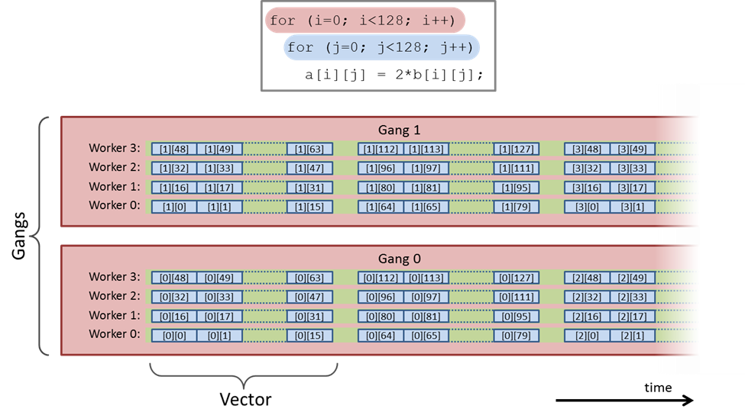
Parallel Workload Decomposition
Gangs
Workers
Vectors

Slide 49
Parallel Execution Semantics
Compute region execution on accelerator starts in gang-redundant mode (GR)
Each gang executes the same code
Once a parallel code is encountered, the execution switches to gang-partitioned (GP) mode
Loop iterations are distributed across gangs
Only one worker active per gang (worker-single, or WS mode)
If only one vector lane is used by the worker, it proceeds in vector-single (VS) mode
If parallel region (or its section) is marked for worker-level work sharing, it switches to worker-partitioned mode (WP)
GP and WP modes may be activated at the same time
Frequently processing may benefit from vector-level parallelization (e.g., leveraging SIMD units), thus initiating vector-partitioned (VP) mode
VP mode may be activated concurrently with any combination of gang and worker modes

Slide 50
Common OpenACC Library Calls
acc_get_num_devices obtains the number of attached accelerators
acc_get_device_type indicates current device type
acc_set_device_type sets the preferred device type for execution of parallel regions of code
acc_get_device_num returns the index of device of specified type
acc_set_device_num selects specific device to execute parallel code
Device types typically include: acc_device_nvidia, acc_device_radeon, and acc_device_xeonphi
Macro _OPENACC may be used to check the implementation version

Slide 51
OpenACC Library Calls Example
Code
Output (executed on Cray XK7)
001 #include <stdio.h>
002 #include <openacc.h>
003
004 int main() {
005 printf("Supported OpenACC revision: %d.\n", _OPENACC);
006
007 int count = acc_get_num_devices(acc_device_nvidia);
008 printf("Found %d Nvidia GPUs.\n", count);
009 int n = acc_get_device_num(acc_device_nvidia);
010 printf("Default accelerator number is %d.\n", n);
011
012 return 0;
013 }
Supported OpenACC revision: 201306.
Found 1 Nvidia GPU(s).
Default accelerator number is 0.

Slide 52
OpenACC Environment Variables
ACC_DEVICE_TYPE sets the default device type for parallel execution
ACC_DEVICE_NUM determines the index of default device to be used
ACC_PROFLIB selects path to the profiling library

Slide 53
The parallel Directive
#pragma acc parallel [clause-list]
structured-block
Identifies structured-block as parallel execution region
It creates one or more gangs
The number of gangs, workers, and vector is constant within the region
The execution is terminated by an implicit barrier at the end of the region (all parallel work must finish before the following code statements are executed)

Slide 54
Select Clauses of parallel Directive
async [(integer-expression)] permits the host to immediately execute the code following the parallel region (removes the barrier)
wait [(integer-expression-list)] blocks the current host thread until all listed asynchronous regions complete their execution
num_gangs(integer-expression) specifies the number of gangs to be used
num_workers(integer-expression) requests specific number of workers per gang
vector_length(integer-expression) assigns specific number of vector lanes to each worker

Slide 55
Asynchronous Execution Example
001 #include <stdio.h>
002
003 const int N = 1000;
004
005 int main() {
006 int vec[N];
007 int cpu_sum = 0, gpu_sum = 0;
008
009 // initialization
010 for (int i = 0; i < N; i++) vec[i] = i+1;
011
012 #pragma acc parallel async
013 for (int i = 100; i < N; i++) gpu_sum += vec[i];
014
015 // the following code executes without waiting for GPU result
016 for (int i = 0; i < 100; i++) cpu_sum += vec[i];
017
018 // synchronize and verify results
019 #pragma acc wait
020 printf("Result: %d (expected: %d)\n", gpu_sum+cpu_sum, (N+1)*N/2);
021
022 return 0;
023 }
Code:
Output:
Result: 500500 (expected: 500500)

Slide 56
The kernels Directive
#pragma acc kernels [clause-list]
structured-block
Converts structured-block into sequence of parallel kernels
The number of gangs, workers, and vector lanes may be different for each kernel
Typically one kernel is created for each loop nest
The parallelization parameters are determined by the compiler (may be more convenient for beginners)

Slide 57
Example of kernels Directive
001 #include <stdio.h>
002 #include <stdlib.h>
003
004 const int N = 500;
005
006 int main() {
007 // initialize triangular matrix
008 double m[N][N];
009 for (int i = 0; i < N; i++)
010 for (int j = 0; j < N; j++)
011 m[i][j] = (i > j)? 0: 1.0;
012
013 // initialize input vector to all ones
014 double v[N];
015 for (int i = 0; i < N; i++) v[i] = 1.0;
016
017 // initialize result vector
018 double b[N];
019 for (int i = 0; i < N; i++) b[i] = 0;
020
021 // multiply in parallel
022 #pragma acc kernels
023 for (int i = 0; i < N; i++)
024 for (int j = 0; j < N; j++)
025 b[i] += m[i][j]*v[j];
026
027 // verify result
028 double r = 0;
029 for (int i = 0; i < N; i++) r += b[i];
030 printf("Result: %f (expected %f)\n", r, (N+1)*N/2.0);
031
032 return 0;
033 }

Slide 58
Example of kernels Directive (cont.)
Fixed size matrix-vector multiplication
Two level loop nest executed on accelerator (lines 23-25)
Output:
Result: 125250.000000 (expected 125250.000000)

Slide 59
Data Offload Management
copy(variable-list)
Performs data copies on entry and exit from parallel region
On region entry:
If data don’t exist in accelerator’s memory, sufficient space is allocated and data transfer from host memory is initiated; the reference count is set to one
If data already exist, their reference count is incremented
On region exit:
The reference count is decremented
If reference count is zero, the memory is deallocated

Slide 60
Data Offload Management (cont.)
copyin(variable-list)
The data are copied on entry to parallel region
Reference counts updated as for the copy clause
copyout(variable-list)
Copies data upon exit from parallel region
Other operations (including reference counting) are performed as described for copy with the exception of initial data copy from host memory
create(variable-list)
Creates data structure in accelerator’s memory
No data transfers between host and device memory are performed
Reference counting is handled as described for the copy clause

Slide 61
Supported Array Types
Statically allocated arrays
Pointers to fixed arrays
Statically allocated pointer arrays
Pointers to array of pointers
Note: copied data must be contiguous in host memory!
int cnt[4][500];
typedef double vec[1000];
vec *v1;
float *farray[500];
double **dmat;

Slide 62
Example: Matrix-Vector Multiplication Using copy Clauses
001 #include <stdio.h>
002 #include <stdlib.h>
003
004 int main(int argc, char **argv) {
005 unsigned N = 1024;
006 if (argc > 1) N = strtoul(argv[1], 0, 10);
007
008 // create triangular matrix
009 double **restrict m = malloc(N*sizeof(double *));
010 for (int i = 0; i < N; i++)
011 {
012 m[i] = malloc(N*sizeof(double));
013 for (int j = 0; j < N; j++)
014 m[i][j] = (i > j)? 0: 1.0;
015 }
016
017 // create vector filled with ones
018 double *restrict v = malloc(N*sizeof(double));
019 for (int i = 0; i < N; i++) v[i] = 1.0;
020
021 // create result vector
022 double *restrict b = malloc(N*sizeof(double));
023
024 // multiply in parallel
025 #pragma acc kernels copyin(m[:N][:N], v[:N]) copyout(b[:N])
026 for (int i = 0; i < N; i++)
027 {
028 b[i] = 0;
029 for (int j = 0; j < N; j++)
030 b[i] += m[i][j]*v[j];
031 }
032
033 // verify result
034 double r = 0;
035 for (int i = 0; i < N; i++) r += b[i];
036 printf("Result: %f (expected %f)\n", r, (N+1)*N/2.0);
037
038 return 0;
039 }

Slide 63
Loop Scheduling
#pragma acc loop [clause-list]
for (…)
May be specified as a separate directive (shown above) or a clause in parallel or kernels directive
Applies to the for loop following immediately
Accepts a number of additional clauses discussed in the next pages

Slide 64
Loop Clauses
collapse: determines how many nested loop levels are affected by the scheduling clauses (default: only the nearest loop following the directive)
gang: distributes iteration of the affected loops across available gangs
worker: controls assignment of loop iterations to workers
vector: affects execution of loop iterations in vector or SIMD mode
auto: forces the compiler to analyze data dependencies to come up with parallelization strategy (implied by default in the kernels directive)
independent: forces the compiler to treat loop iterations as data independent
reduction: assigns specified scalar variables as a shared reduction variables along with a reduction operation to be carried out at the end of the loop

Slide 65
Reduction Example
001 #include <stdio.h>
002 #include <stdlib.h>
003
004 const int N = 10000;
005
006 int main() {
007 double x[N], y[N];
008 double a = 2.0, r = 0.0;
009
010 #pragma acc kernels
011 {
012 // initialize the vectors
013 #pragma acc loop gang worker
014 for (int i = 0; i < N; i++) {
015 x[i] = 1.0;
016 y[i] = -1.0;
017 }
018
019 // perform computation
020 #pragma acc loop independent reduction(+:r)
021 for (int i = 0; i < N; i++) {
022 y[i] = a*x[i]+y[i];
023 r += y[i];
024 }
025 }
026
027 // print result
028 printf("Result: %f (expected %f)\n", r, (float)N);
029
030 return 0;
031 }
Code:
Output:
Result: 10000.000000 (expected 10000.000000)

Slide 66
Variable Scope
Depends on the location of their declarations in the code
Loop variables are considered private to each thread that executes loop iterations
Variables declared within vector-partitioned code are private to thread associated with each vector lane
For code executed in worker-partitioned, vector-single mode, the variables are private to each worker, but shared across vector lanes associated with that worker
Variables declared in a worker-single block are private to the containing gang, but shared across workers and vector lanes in that gang

Slide 67
Variable Scope Restrictions
private clause
Accepts variable names as argument
A private copy is created for each parallel gang in parallel directive
Copies created for thread associated with each vector lane in the loop context
firstprivate
Used with the parallel construct
Semantics similar to private, but additionally initialized to the variable value stored in the first thread encountering the parallel directive

Slide 68
Atomics Support
#pragma acc atomic [atomic-clause]
statement;
Separate clauses for read, write, update, and capture
update clause is assumed by default (i.e., read-modify-update semantics)
capture clause is used to store the original or final value of atomically updated variable

Slide 69
Atomic Variable Example
001 #include <stdio.h>
002
003 int main(int argc, char **argv) {
004 if (argc == 1) {
005 fprintf(stderr, "Error: file argument neede!\n");
006 exit(1);
007 }
008 FILE *f = fopen(argv[1], "r");
009 if (!f) {
010 fprintf(stderr, "Error: could not open file \"%s\"\n", argv[1]);
011 exit(1);
012 }
013
014 const int BUFSIZE = 65536;
015 char buf[BUFSIZE], ch;
016 // initialize histogram array
017 int hist[256], most = -1;
018 for (int i = 0; i < 256; i++) hist[i] = 0;
019
020 // compute histogram
021 while (1) {
022 size_t size = fread(buf, 1, BUFSIZE, f);
023 if (size <= 0) break;
024 #pragma acc parallel loop copyin(buf[:size])
025 for (int i = 0; i < size; i++) {
026 int v = buf[i];
027 #pragma acc atomic
028 hist[v]++;
029 }
030 }
031 // print the first highest peak
032 for (int i = 0; i < 256; i++)
033 if (hist[i] > most) {
034 most = hist[i]; ch = i;
035 }
036 printf("Highest count of %d for character code %d\n", most, ch);
037
038 return 0;
039 }

